Slide 1
PYTEST

Slide 2

Overview
Python syntax
Fixtures for managing test resources
Supported by Python 2.7, 3.4+
Easy to install
Rich plugin architecture (over 300 plugins)

Slide 3
Installation
pip install pytest==7.2.0
pytest --version
This is pytest 7.2.0
Success :)

Slide 4
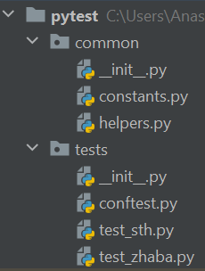
Structure
Base “project” structure:
Modules with tests (test_*.py or *_test.py by default)
and conftest.py
Test data, python modules with helpers etc

Slide 5
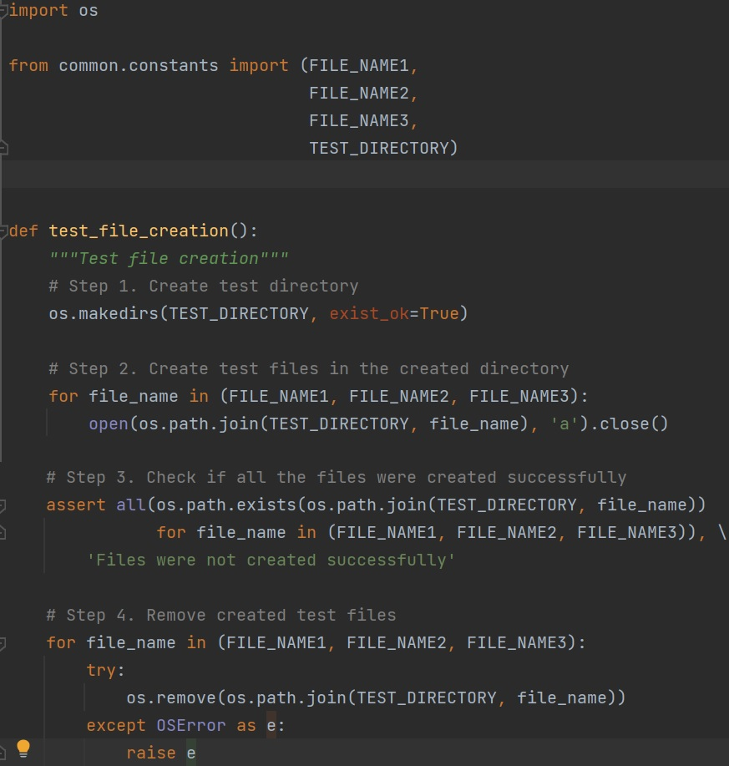
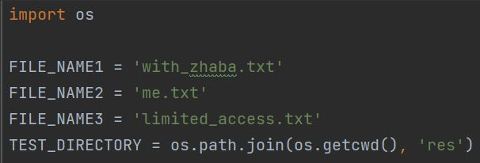
First test
<- common/constants.py
What’s wrong with this test?
<- tests/test_file.py

Slide 6
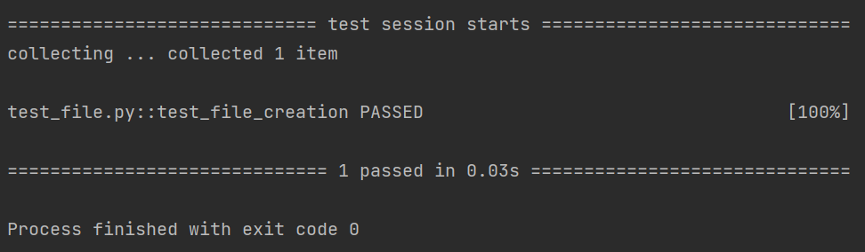
Test invocation
pytest [options] tests
python –m pytest [options] tests *
*also adds current directory to sys.path
Status codes:
Exit code 0 All tests were collected and passed successfully
Exit code 1 Tests were collected and run but some of tests failed
Exit code 2 Test execution was interrupted by user
Exit code 3 Internal error happened while executing tests
Exit code 4 Pytest command line usage error
Exit code 5 No tests were collected

Slide 7
Pytest fixtures
Pytest fixtures are functions which are being used to create a specific environment for the test
Fixtures have explicit names and are activated by declaring their use from test functions, modules,
classes or whole project
Fixtures are implemented in a modular manner, as each fixture name trigger a fixture function
which can itself use other fixtures
Fixture management scales from simple unit to complex functional testing,
allowing to parametrize fixtures and tests according to configuration and component options

Slide 8
Basic fixtures
Functional style:
OOP style:
def setup_module()
def setup_function()
def test1…N()
def teardown_function()
def teardown_module()
def setup_module()
def setup_class()
def setup_method()
def test1…N()
def teardown_method()
def teardown_class()
def teardown_module()
def setup_session()
def teardown_session()
— setup and teardown for the whole session

Slide 9
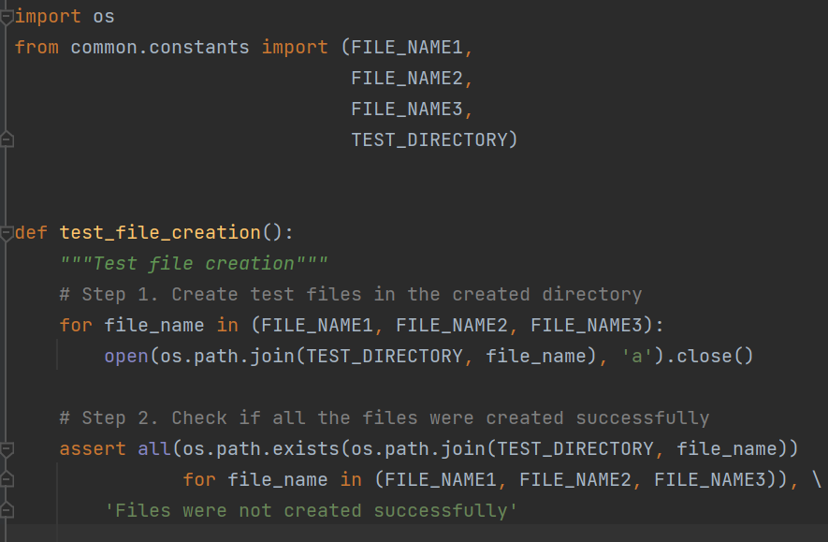
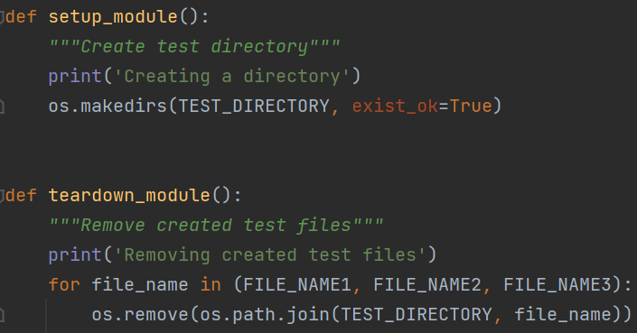

Basic fixtures example
../tests/test_file.py
Zhaba was here

Slide 10
Extended fixtures
How to create a fixture:
Import the pytest module
Wrap up the function with the @pytest.fixture() decorator
Define a scope for the fixture: function (default), cls, module or session
Add a finalizer into the function if it is necessary
How to apply a new fixture to the test function:
Add a name of created fixture as a test function parameter
Or wrap up the test function/class with @pytest.mark.userfixture(‘fixture_name’)
Or put fixtures required by all tests into an .ini file
10

Slide 11
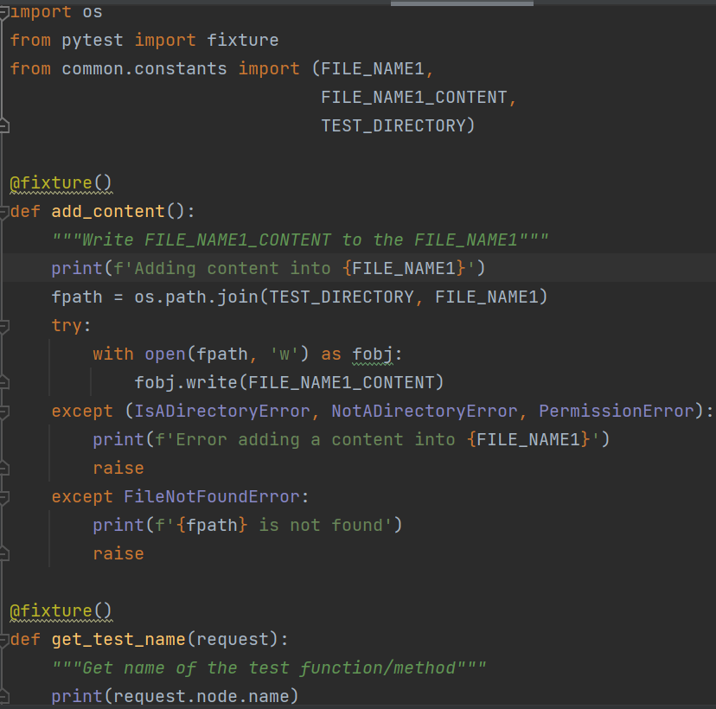
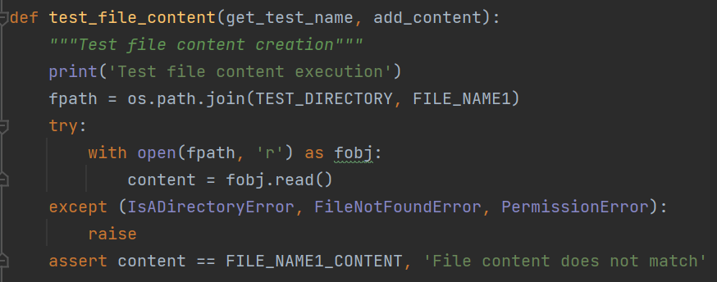
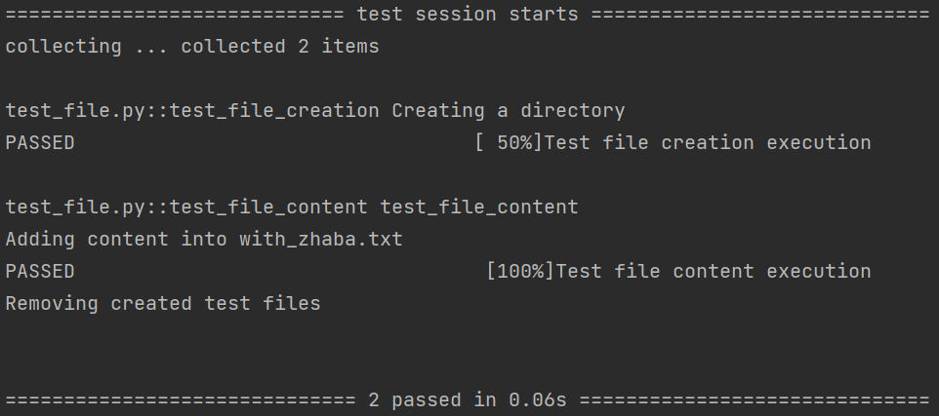
Extended fixtures example
../tests/test_file.py
../tests/conftest.py ->

Slide 12
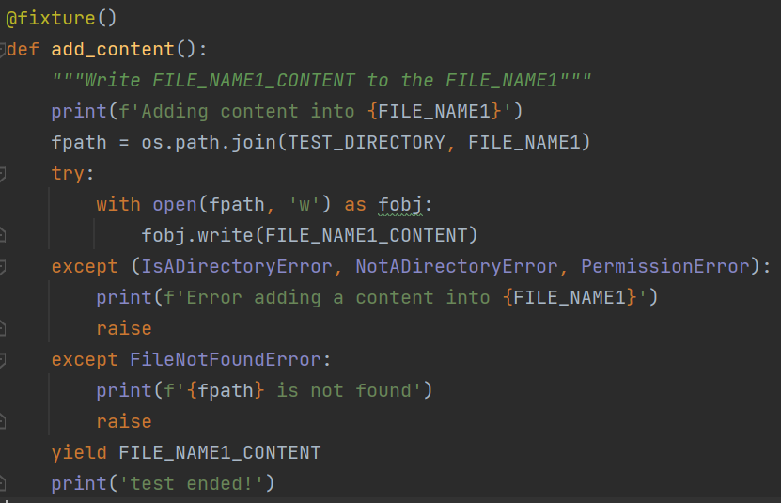
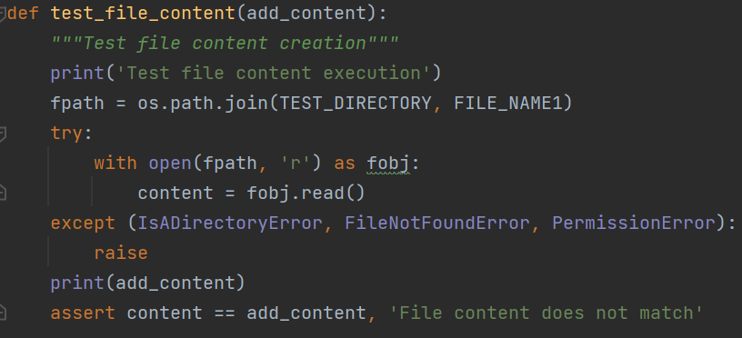
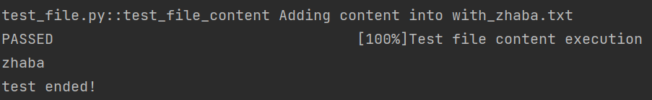
Extended fixtures example
../tests/test_file.py
../tests/conftest.py

Slide 13

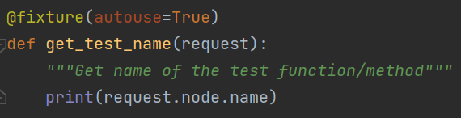
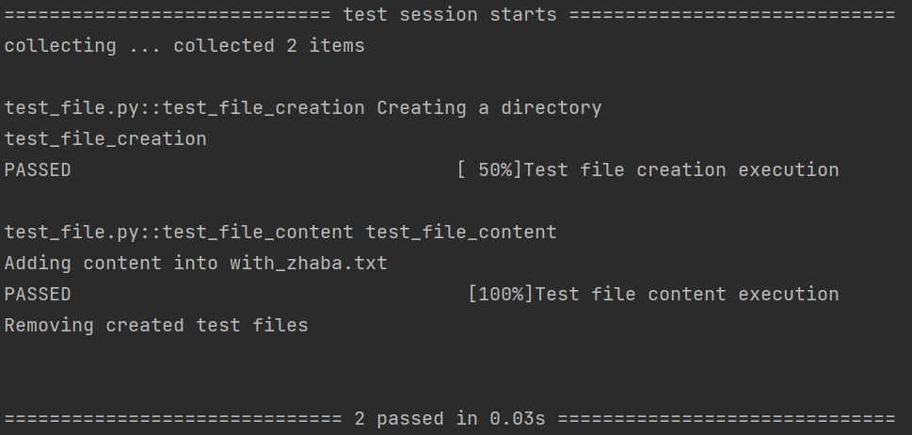

Other ways to use fixtures
../tests/test_file.py
../tests/conftest.py
our_project/pytest.ini

Slide 14
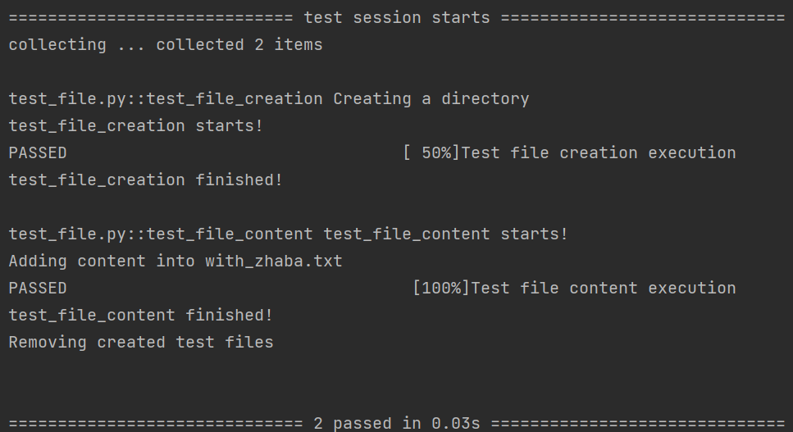
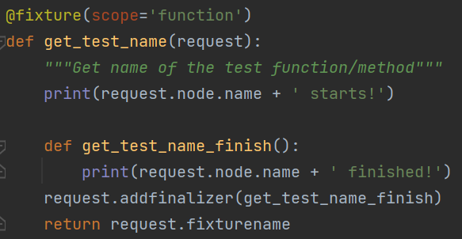
finalizers
../conftest.py

Slide 15
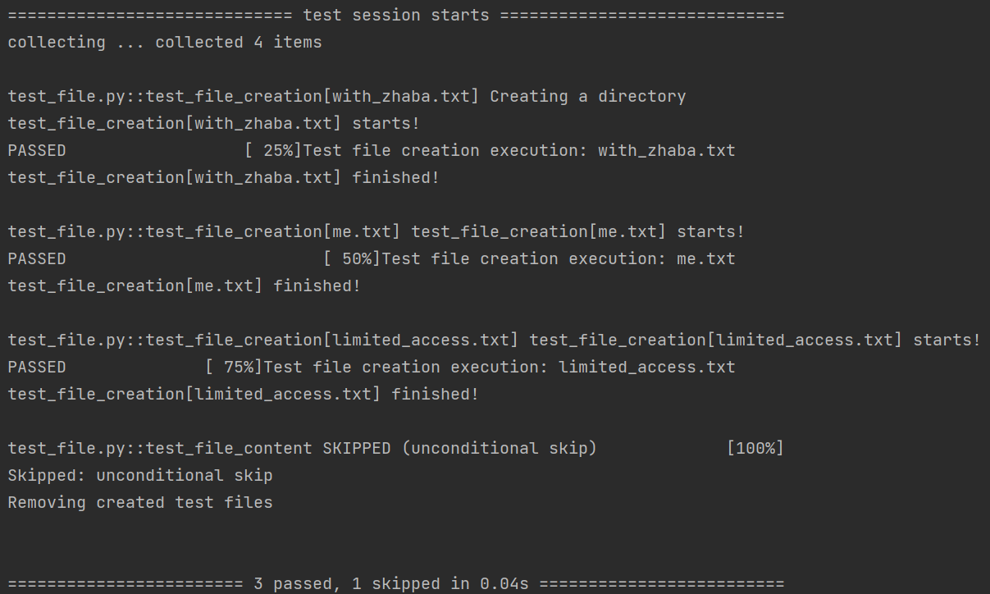
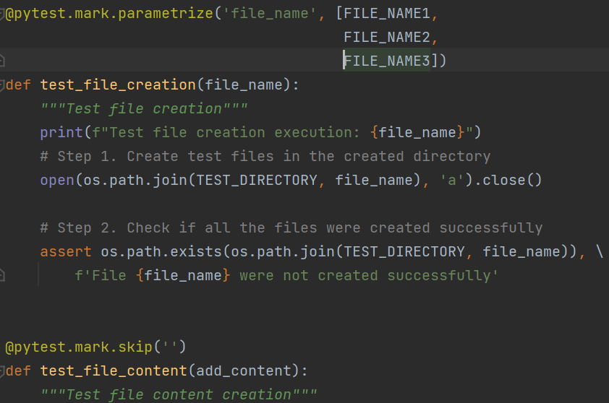
markers
skip – always skip a test function
skipif – skip a test function if a certain condition is met
xfail – produce an expected failure outcome if a certain
condition is met
parametrize – perform multiple calls to the same
test function
Custom markers:
@pytest.mark.some_custom_mark
>pytest path/to/tests –m ‘some_custom_mark’

Slide 16
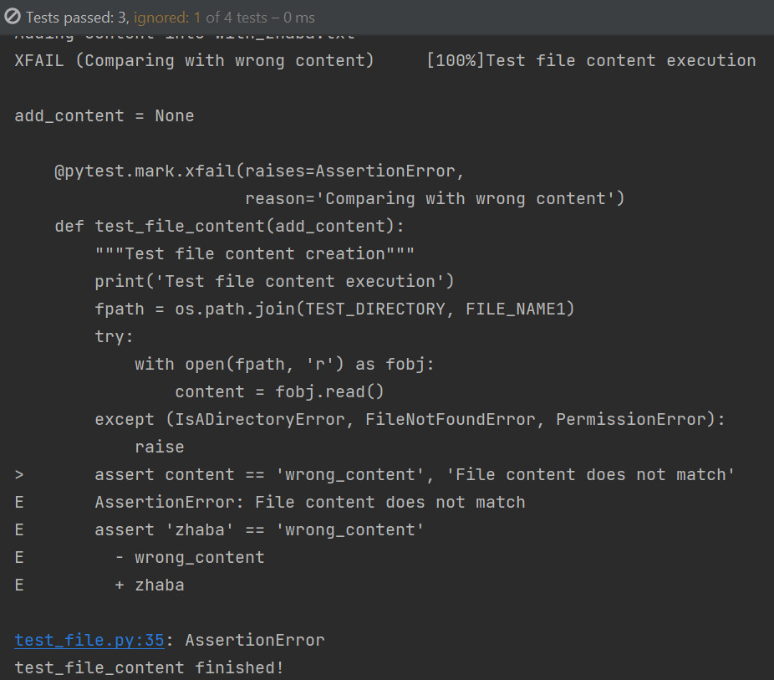
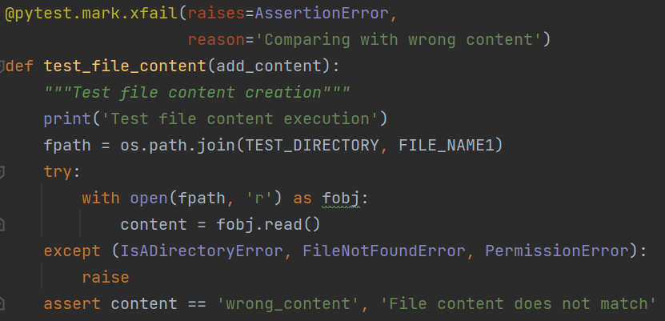
Markers

Slide 17
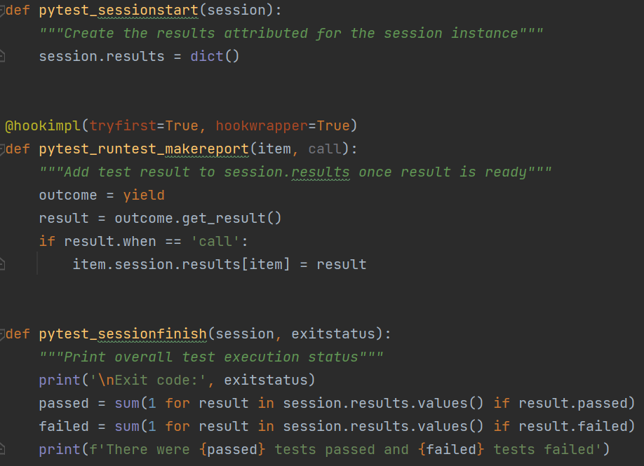
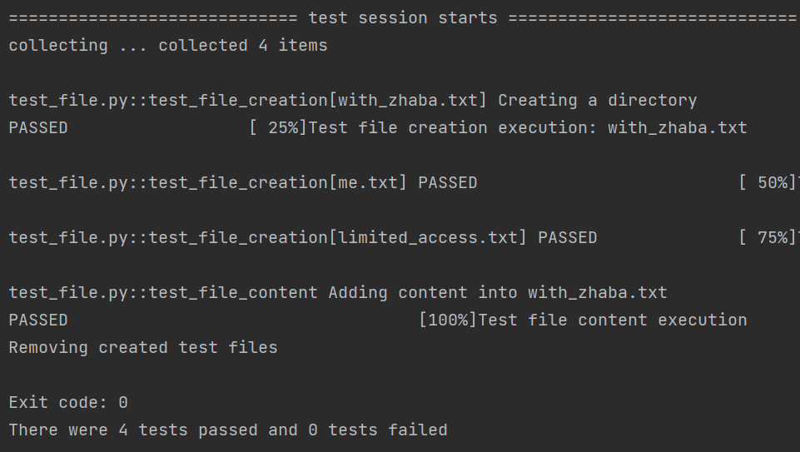
Pytest hooks
Pytest hooks allow users to make changes in default behavior without changing either framework’s code or tests itself
../conftest.py

Slide 18

rerun
pytest-cache plugin command line options:
--last-failed – to only re-run the failures
--failed-first – to run the failures first and then the rest of the tests
--cache-clear – allows to remove all cross-session cache contents ahead of a test run -> no rerun
pytest-rerunfailures plugin:
--rerun n – to re-run tests maximum n times
--rerun-delay s – to add wait s seconds before the next re-run
--only-rerun SomeException – to re-run only those failures
that match a certain exception
@pytest.mark.flaky(reruns=5, reruns_delay=2) – to apply to individual test
our_project/pytest.ini
to disable the plugin
(or use command line)

Slide 19
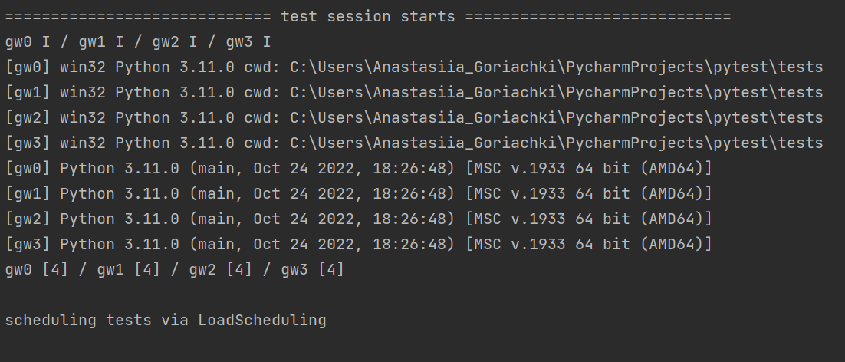
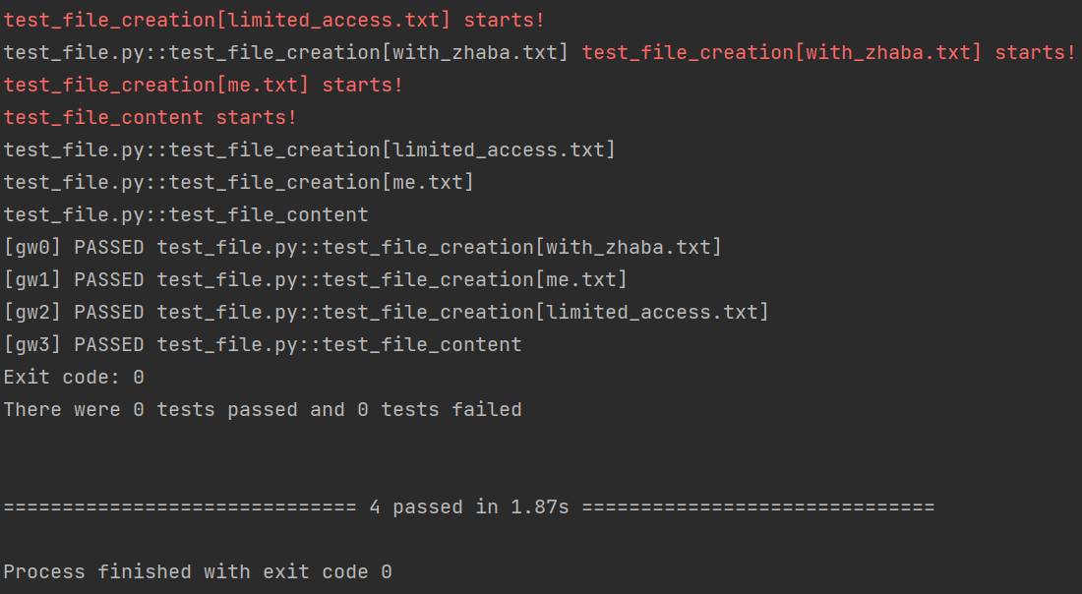
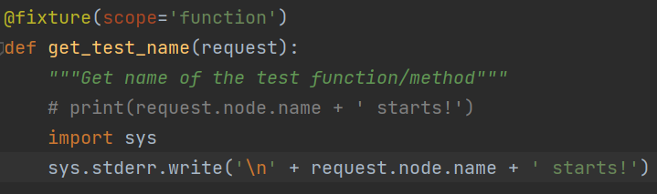
Running in parallel
pytest-xdist — plugin for parallel test execution
pytest -n 4 path/to/tests
Avoid test dependency!
@pytest.fixture(scope=“session”)
@pytest.fixture(scope="function“)
Pytest-xdist uses sys stdin/stdout to control execution
use std.err
use capsys fixture

Slide 20
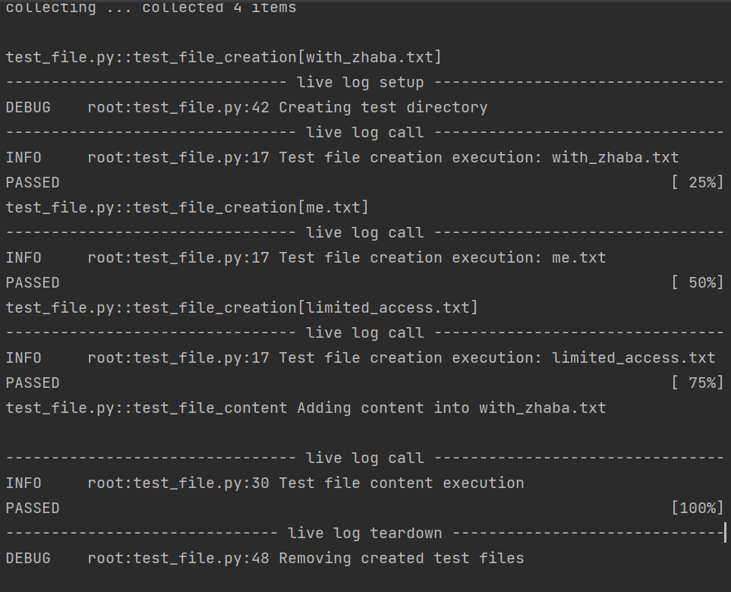
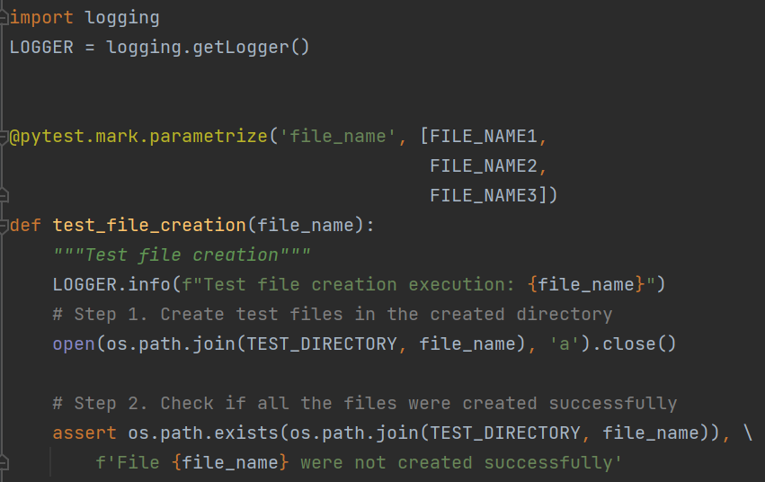
Logging
Pytest captures log messages of level WARNING or above automatically and displays them in their own section
for each failed test in the same manner as captured stdout and stderr
Use command line arguments to enable logging –log-cli-level DEBUG
Or define logging options in pytest.ini file

Slide 21
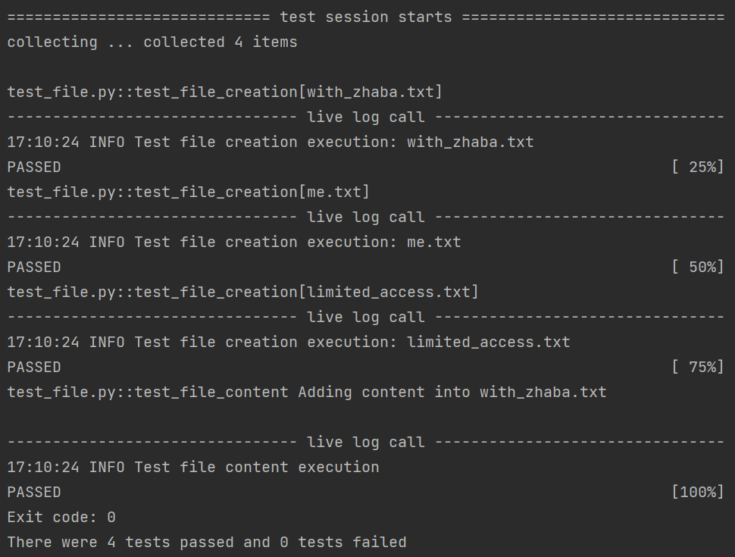
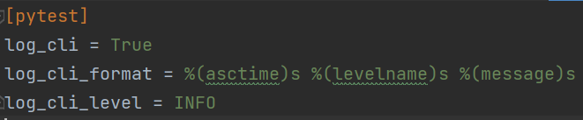
Logging
../pytest.ini
Only INFO level logs are displayed
Formatting applied
Log to file:
log_file = pytest_debug.log
log_file_level = DEBUG
*log_format will be applied to both cl and file unless
log_cli_format or log_file_format is specified

Slide 22
THE END :)

